Slide 1
CABLES

Slide 2
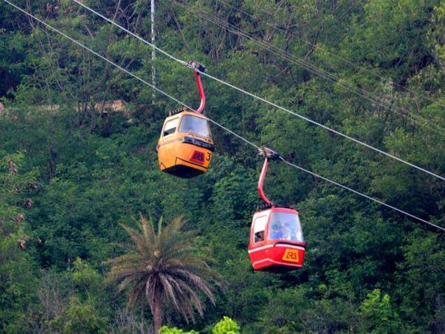

Slide 3
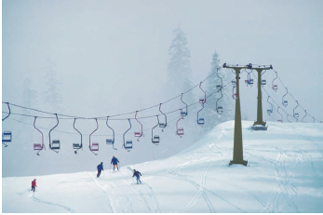

Slide 4
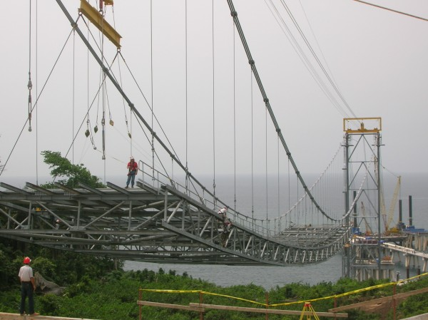

Slide 5
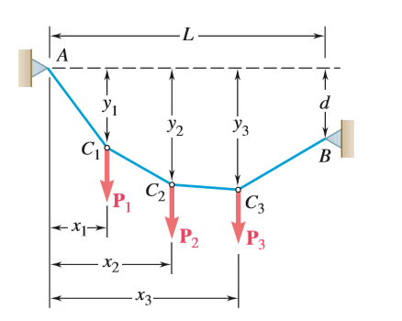
Cable with Concentrated Load

Slide 6
Unsolved Examples

Slide 7

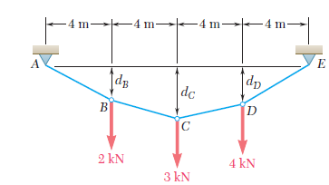
V_{E} =5 kN, H_{E} = 8 kN, F_{CD} = 9.43 kN

Slide 8

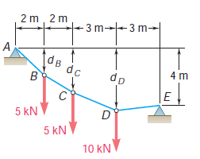

Slide 9
V_{A} =18.57 kN, H_{A} = 21.429 kN
V_{E} = 1.429 kN, H_{E} = 21.429 kN
d_{B} = 1.733 m, d_{D}= 4.20 m

Slide 10

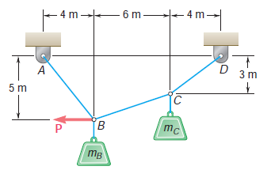
P = 196.2 N

Slide 11
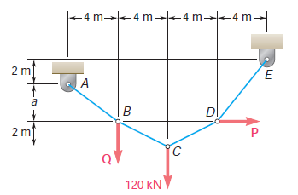
3 m
P = 72 kN, Q = 30 kN

